Slide 1
Digital Portfolio
STUDENT NAME: M.AFRA FATHIMA
REGISTER NO AND NMID: 24134130500122001 and 41341324213001
DEPARTMENT: II-BCA
COLLEGE: DEEN COLLEGE OF ARTS AND SCIENCE

Slide 2
PROJECT TITLE
STUDENT DIGITAL PORTFOLIO

Slide 3
AGENDA
Problem Statement
Project Overview
End Users
Tools and Technologies
Portfolio design and Layout
Features and Functionality
Results and Screenshots
Conclusion
Github Link

Slide 4
PROBLEM STATEMENT
Design and develop a responsive and interactive digital portfolio website for a student using HTML, CSS, and JavaScript. The website should showcase the student’s profile, education, projects, skills, and contact information with features like smooth navigation, dark mode, and a functional contact form.

Slide 5
PROJECT OVERVIEW
A student digital portfolio is a curated online collection of a student work , showcasing their progress , skills , and achievement over time to demonstrate their learning journey and growth.It includes various “artifacts” like projects , essays , presentation , artwork , and even reflections on their learning process , providing a comprehensive and interactive display for teachers , parents , and future institution.

Slide 6
WHO ARE THE END USERS?
The end users of a Student Digital Portfolio built HTML , CSS , and Javascript are primarily individuals and organization who need to evaluate or understand the student skills , projects , and achievements.
These End Users Include:
Prospective Employees
Admission Committees
Mentors and Education
Clients(for freelance students)
Peers and Collaboration
The student Themselves

Slide 7
TOOLS AND TECHNIQUES TOOLS USED:
HTML5 – For structuring the content of the portfolio.
CSS3 – For styling, layout, animations, and responsiveness.
JavaScript (Vanilla JS) – For interactivity like dark mode toggle, smooth scrolling, and form validation.
Code Editor – Examples: VS Code, Sublime Text, Notepad++.
Web Browser – For testing and previewing (Chrome, Firefox, Edge).
TECHNIQUES USED:
Responsive Web Design – Using flexible layouts and media queries for mobile compatibility.
Flexbox Layout – To organize content sections and project cards neatly.
Linear Gradient Backgrounds – For modern and attractive design aesthetics.
Smooth Scrolling – For easy navigation between sections.

Slide 8
POTFOLIO DESIGN AND LAYOUT
Visual Design Elements:
Home
Projects
Contact
Colors:
Primary Gradient
Secondary Gradients:
Fonts:
Sans-serif (Arial, Helvetica) for modern, clean look.
Cards and Buttons:
Rounded corner(border-radius 15px for cards , 25px for buttons)
Subtle shadows for depth.
Hover animations for interactivity.

Slide 9
POTFOLIO LAYOUT
Section | Purpose | Key Design Features layout
Header | Navigation bar with links and dark mode toggle | Fixed at the top, gradient background, white text, hover animation
Home | Introduction with profile picture | Gradient background, profile image with shadow, centered intro text and button
Education | Academic history | Clean white background, left-aligned list with colored border accent
Projects | Showcase of projects | Cards layout in a responsive grid, hover animations
Skills | List of technical skills | Colorful pill-style badges, hover scaling effect
Contact | Contact form | Gradient background, shadowed input fields, and submit button
Footer | Closing note | Dark background, centered white text

Slide 10
FEATURES AND FUNCTIONALITY
Key Features and Functionality
Responsive Design - Works smoothly on mobile, tablet, and desktop.
Dark Mode Toggle – Switch between light and dark themes instantly.
Smooth Navigation – Click menu items or buttons to scroll smoothly to sections.
Project Showcase – Displays projects with images, titles, and descriptions.
Contact Form with Validation – Simple form that shows success or error messages based on user input.
Clean Code Structure – HTML for structure, CSS for design, and JavaScript for interactivity.

Slide 11
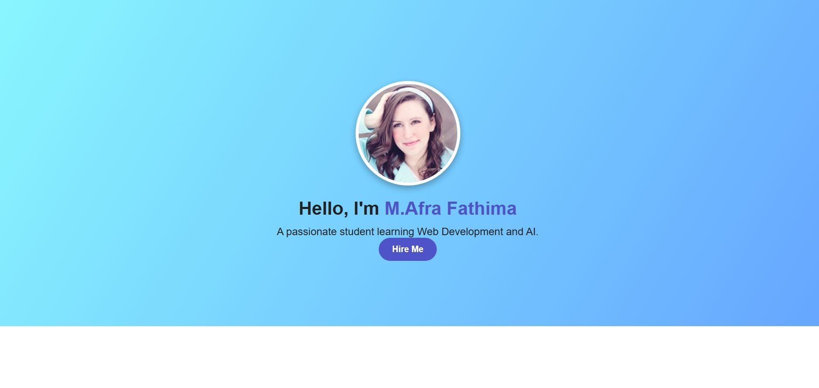
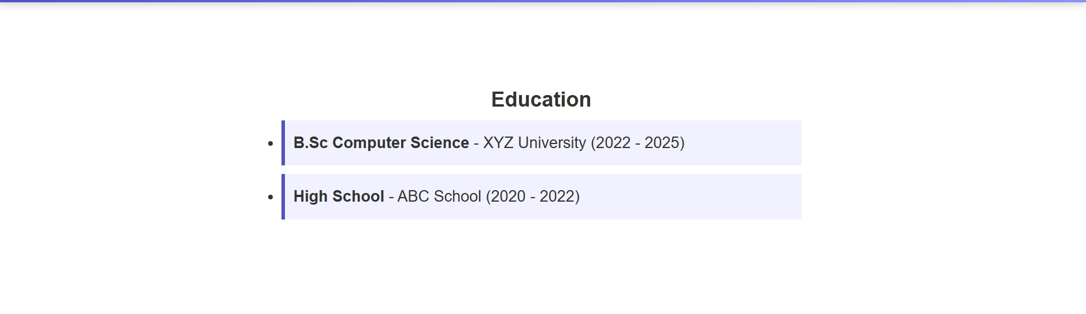
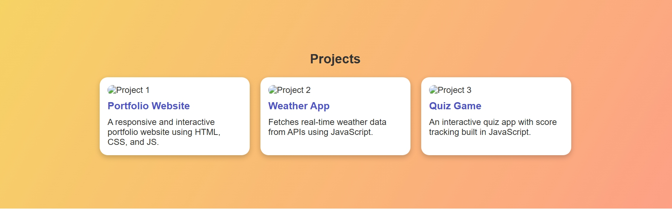
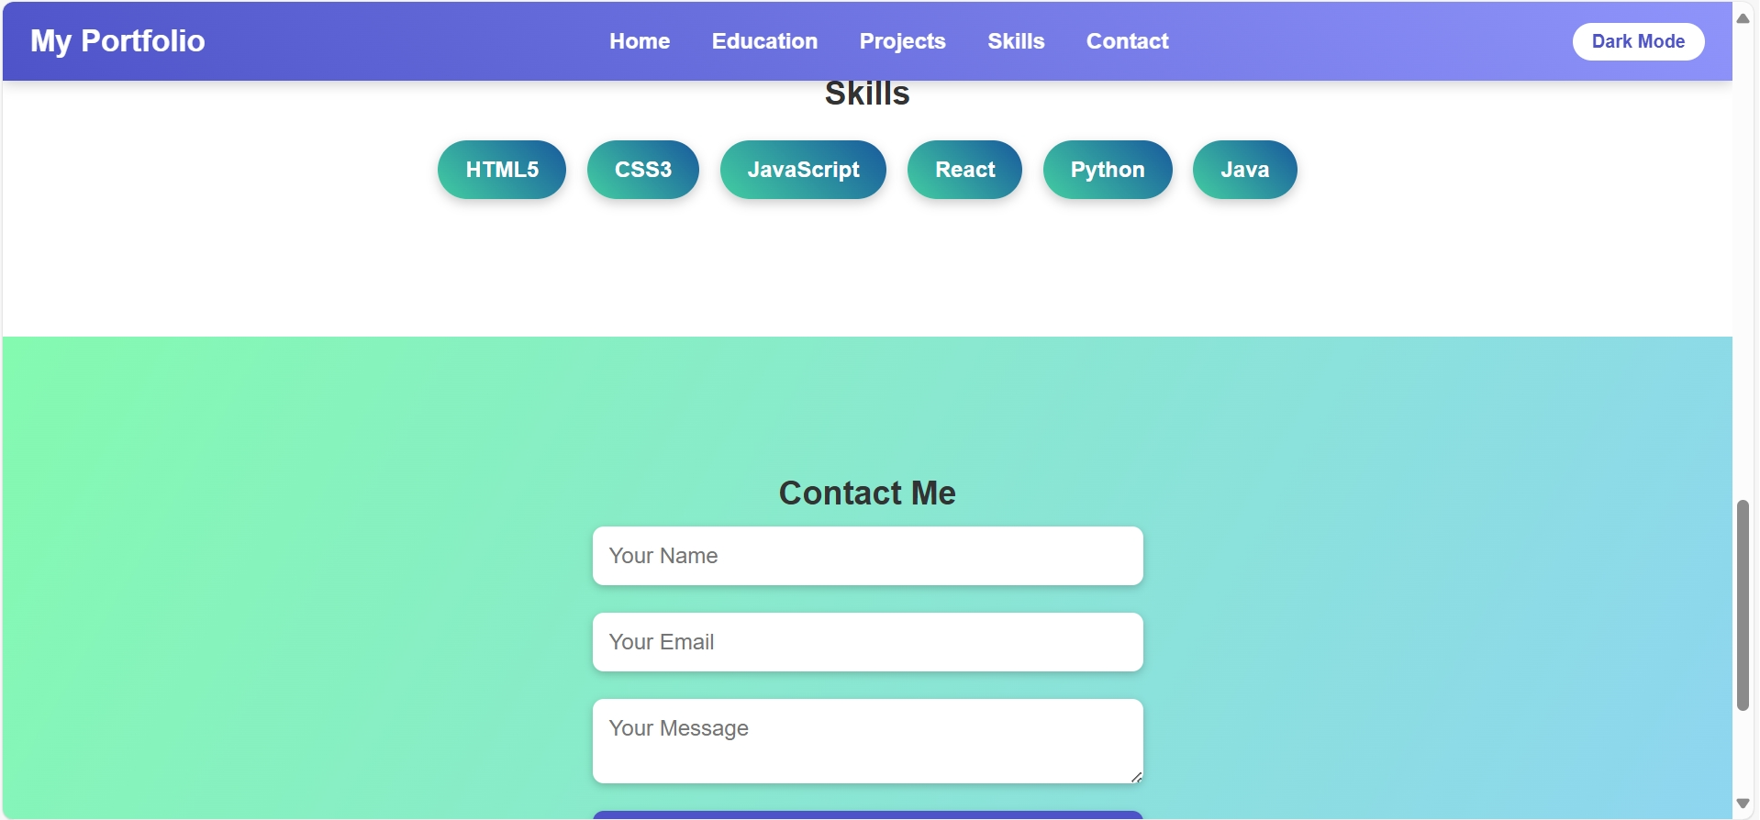
RESULTS AND SCREENSHOTS

Slide 12
CONCLUSION
The Conclusion of Student Digital Portfolio is their essential role in Showcasing Growth , Reflecting on Learning , Developing Personal Brands , and Preparing Students for the future by providing a comprehensive , Dynamic Archive of Achievements that serve as a modern resume for academic and professional pursuits.

Slide 13
GITHUB LINK
Github Link:
https://github.com/dcbca24afra-ship-it/M.-Afra-Fathima-FWD.git

